Slide 1
eProcurement 101
November 6, 2024
Notes:
Karen

Slide 2
Agenda
Welcome & Introduction
Procurement Technology Overview
Systemwide Contract Executed
Next Steps: Unlocking Systemwide Contract Purchases
From Cart to Completion: The eProcurement Journey
Current ePro Technology Landscape
Holistic ePro Support: Empowering Efficiency
Q&A
Notes:
Karen

Slide 3
SW Procurement Systems Team Overview
CalUsource
Kevin Pham
ePro
Terese Merrell
Nate Mann
Benefit
Karen Rhee
Help Desk
Sneha Thomas
Open Position*
Open Position*
*One open position
Notes:
Karen

Slide 4
Procurement Technology Overview
Spend
Analysis
Strategic
Sourcing
Contract
Execution
Supplier
Management
Requisition
PO
Receipt
Invoicing
Payment
Source-to-Contract Technology
S2C | Upstream | CalUsource
Procure-to-Pay Technology
P2P | Downstream | ePro | Jaggaer, Labvivia, Oracle
Source-to-Pay Technology
Notes:
Karen

Slide 5
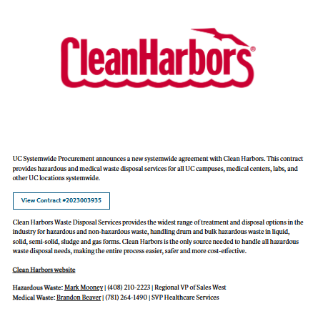
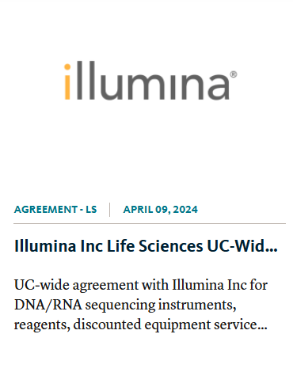
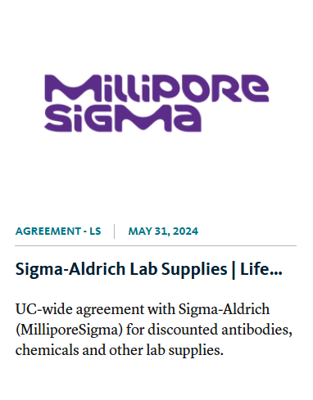
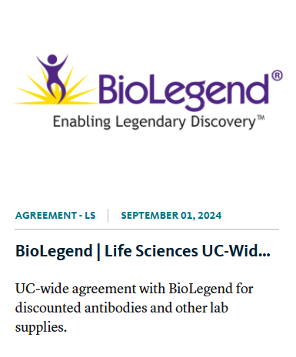
Systemwide Contract Executed
“ Great news! I got the announcement.
Now, what’s the next step? How do I start making purchases?”
Notes:
Karen

Slide 6








Next Steps: Unlocking Systemwide Contract Purchases
E-commerce
Strategy
Development
Price File
Supplier
Selection
Price file and catalog enablement in
Systemwide consortium technology
CATALOG
Hosted | Punchout
Contract signed
Supplier
Hosted content & contract deployed to
Campus ePro Platforms
Notes:
Terese

Slide 7
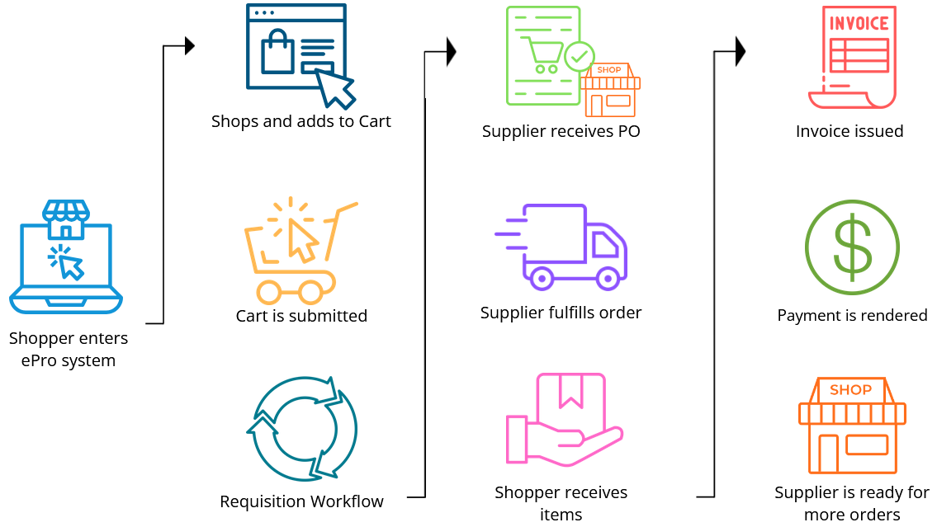
From Cart to Completion: The eProcurement Journey
Notes:
Nate

Slide 8














Current ePro Technology Landscape
&

Slide 9






Holistic ePro Support: Empowering Efficiency
Catalogs & Content:
22 new catalog enablements (FY 2024)
81 price files processed (FY 23-24)
Technology Support:
Labviva product management
Jaggaer release evaluations
ePro Supplier Management:
Primary contact
Supplier changes across ePro systems
Process improvement:
UCSD & UCM incorporated into price file process
Guided Buying for UCSC
Small & Diverse Spend:
Pilot & Rollout of Fisher/Possible Missions
Neta/Agilent project
Sourcing & Contracting:
Consult on ePro opportunities
Four LS, two IT and two FM&C RFPs with ePro

Slide 10
Q&A

Slide 11
Appendix 1: Glossary
TERM | DEFINITION
Amazon Business | Amazon shopping experience for businesses. The ePro team manages the UC Central AB account for 5 campus & OP Local
Content | Items, pricing and information from a supplier that is compliant with the sourcing strategy, pricing, contract and UC initiatives.
eCommerce Appendix | Appendix to Contracts with an eProcurement component. Details business & technical UC ePro requirements and outlines Content and pricing parameters.
Enablement (catalog/supplier) | The process of setting up, integrating and testing with a supplier. Scope includes and creating a catalog within an e-procurement system, from which end users will shop. Involves a project and collaboration between the supplier, the system/software provider, and the University. Either a Punchout or a Hosted catalog can be enabled.
Hosted catalog | A Price File that has been analyzed & processed by the Price File Analysis System and approved by a Category Manager. The pricing for this type of catalog is static, until a new price file is submitted. Hosted catalog content is visible to shoppers.
Jaggaer | The software service provider that is the platform for uBUY and many individual campus eProcurement systems. Is ERP-agnostic.
Labviva | The software service provider that is the shopping and content management platform for UCSD and UC Merced.
Oracle ePro | The software service provider that is the platform for several of the campus eProcurement systems. Note: Only used for a subset of those campus that have transitioned to an Oracle ERP.
uBUY Consortium | UC Systemwide layer of Jaggaer that allows for systemwide content management. It is the repository for systemwide contracts and associated Price Files that can be shared to consortium members (UC campuses on Jaggaer & Labviva)
Price File | Electronic content (Item and Price) that is submitted by the supplier into the UC’s eprocurement system. It is specific to a customer or consortium, that should contain their UC allowable items & UC pricing. If a Price File is approved, it becomes a Hosted catalog.
Price File Analysis System | A system designed and developed by the ePro team that analysis Price Files and reports on that analysis. It also has workflow tracking and automated notifications. It is built on Smartsheet, Access, and Excel with Power BI.
Punch-out catalog | Feature which allows a shopper to access a UC-specific version of a supplier's website with UC-specific pricing and products. A shopper can add items to his or her shopping cart on the supplier’s site, then return that cart to the e-procurement system for workflow and PO processing. There are different levels of punch-out that can be enabled (see Level 1, Level 2, and Live Price). Which level is enabled is dependent upon the capabilities of each specific supplier.
Notes:
Terese

